Slide 1
DRC 101
Disability Resource Center
Basics for TAs
Available for download at drc.uic.edu/presentations

Slide 2
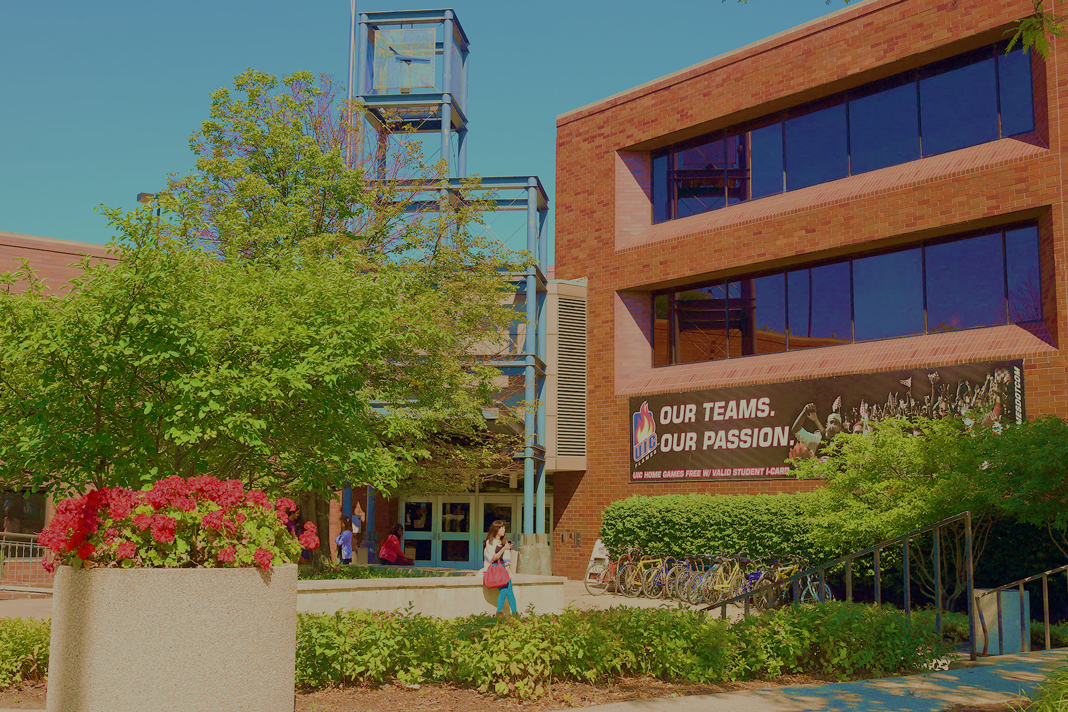
UIC Disability Resource Center
Located in Suite 1070 of SSB
1200 W Harrison Street
http://drc.uic.edu // drc@uic.edu
312-413-2183

Slide 3
DRC REPORTS TO
OFFICE FOR ACCESS AND EQUITY
DISABILITY RESOURCE CENTER
Student Accommodations
Campus Awareness and Outreach
Resource Referrals
OFFICE FOR ACCESS AND EQUITY
Employee Accommodations
Discrimination Complaints
Title IX Compliance and Training
  Pregnancy Accommodations
DISABILITY CULTURAL CENTER
Office of Diversity
Cultural, social and educational programming
Advance disability experience as a social justice issue

Slide 4


DISABILITY RIGHTS LAWS IN HIGHER ED
Passed as a result of civil unrest and protest
Protect students with disabilities from discrimination, exclusion, denial of educational benefits; support “reasonable accommodations”
About removing barriers to ACCESS

Slide 5
REASONABLE ACCOMMODATION (IN BRIEF)
Not an advantage; about removing the barrier to equal access:
Testing accommodations
Sighted lab assistance, interpreting, CART, captioning
Classroom relocation, accessible furniture
Alternate text formats
Peer note taking
Assistive technology and software
Accessible transportation and housing
Attendance and deadline flexibility

Slide 6
Accommodation Process Overview
Disclosure + Request
Interactive Process
Letter of Accommodation
Implementation
Must begin with disclosure of disability and request for accommodations
Interactive Process
Letter of Accommodation
Implementation
If there are issues or concerns with implementation, we may have to re-enter the interactive process
  If it is determined that accommodations must be amended or changed, a new letter of accommodation is created and new accommodations are implemented

Slide 7
MAKING APPROPRIATE REFERRALS
DOs
Make a general announcement about the DRC in Week 1 of class
  DRC Referral Resource Page has syllabus statement, announcement script, and PPT slide
  Emphasize the importance of seeking help if you need it
Renew access invitation around midterm
Refer students who disclose disability status to the DRC (they can call, email, or stop by)

Slide 8
MAKING APPROPRIATE REFERRALS
DON’Ts
Make assumptions about disability status
Ask for or collect medical documentation
Make up accommodations with students outside DRC process
Make discriminatory comments:
  “Are you sure you want to pursue such a difficult career path?”
  “You don’t look disabled.”
Praise or valorize students for not making use of an disability accommodation

Slide 9

WHEN YOU RECEIVE AN LOA
  Don’t feel pressure to respond immediately
  Do not deny accommodations without contacting DRC.
  Consider what you say: this conversation is sensitive, and jokes or off-hand remarks can be very impactful in this moment
  Schedule a time to meet

Slide 10

Implementing Accommodations
Check out the DRC Accommodations Guide if you need more basic information
If an accommodation does not seem reasonable, contact the DRC at drc@uic.edu or (312) 413-2183 before meeting with the student.
What is the letter asking you to do? What details need to be hammered out?
Engage in a private conversation about the student’s accommodations and unique needs in the class
Focus on accommodations, rather than asking a student about the specifics of their disability or diagnosis.
Clearly express how you and the student will work together to implement the accommodations and record expectations

Slide 11
“Quick Guide” for Online Course Accessibility
Available at go.uic.edu/accessibledocs
On DRC website under “Faculty” menu

Slide 12
QUESTIONS?
CALL US: (312) 413-2183 (Google Voice)
DRC.UIC.EDU
DRC@UIC.EDU
Disability Resource Center | Office of Access and Equity

