Slide 1
DRC 101
Accessibility and Accommodations for DGSs
Presented by
Margaret Fink, Director, Disability Cultural Center
Sophia Hamilton, Director, Disability Resource Center
Available for download at drc.uic.edu/presentations

Slide 2
Disability Cultural Center (DCC)
One of seven Centers for Cultural Understanding and Social Change
Work to promote an understanding of disability as a social justice issue and a site for identity and community
Create spaces of belonging for disabled students, staff, faculty--whether they identify as disabled, are exploring their relationship to disability identity, or are thinking through whether they have a disability
Establish forums on campus for celebrating the lived experience of disability & disability culture

Slide 3
Toward a More Accessible Culture at UIC
DCC hosts public programs for thinking through disability and accessibility on a structural level, to understand ableism and its intersection with other systems of privilege and oppression
* * *
Academic ableism and inaccessible learning environments are central to the overall culture of our campus
Students with disabilities or other conditions are confronted over and over with materials, built environments, assessment practices, and social spaces that position them as unanticipated, an interruption, a problem, or a burden/chore
Notes:
Academic ableism and inaccessible learning environments = default modes of instruction serve certain kinds of bodies/minds best, and that’s not often noticed or questioned

Slide 4
Accommodations and Accessibility
Disability Resource Center works hard to make sure disabled students get the adjustments they need in class to give equitable access to our university’s learning environments--accommodations.
This guide takes it as a given that accommodations work best when accessibility is understood as an active, ongoing process
Universal Design is an approach that tries to anticipate as many kinds of users as it knows how and designs for them, building accessibility in from the start

Slide 5
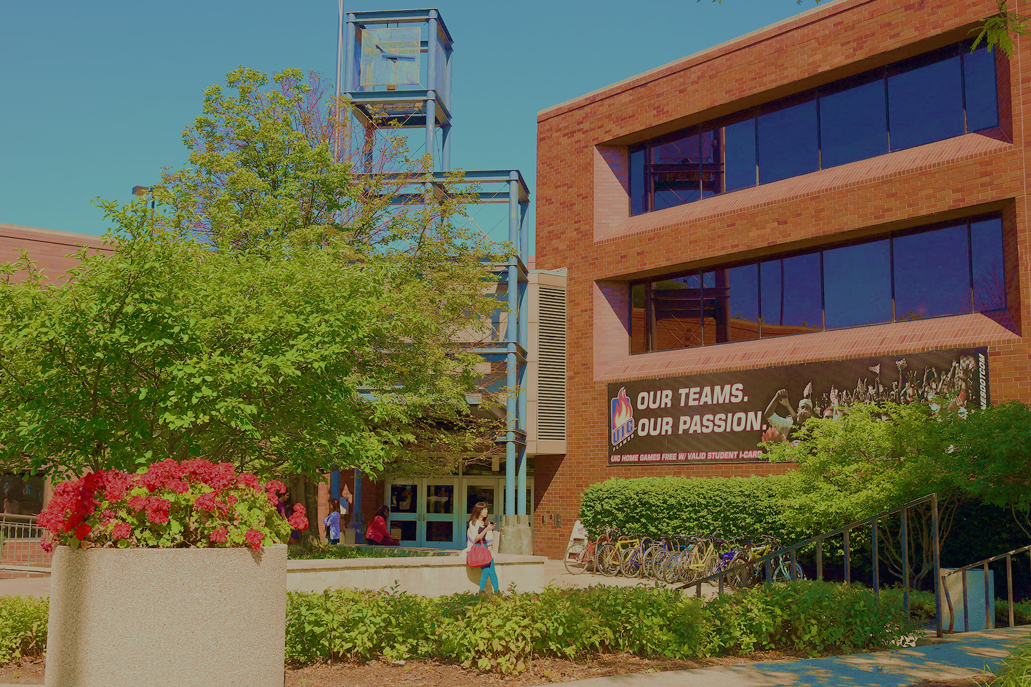
UIC Disability Resource Center
Located in Suite 1070 of SSB
1200 W Harrison Street (remote)
http://drc.uic.edu // drc@uic.edu
312-413-2183

Slide 6
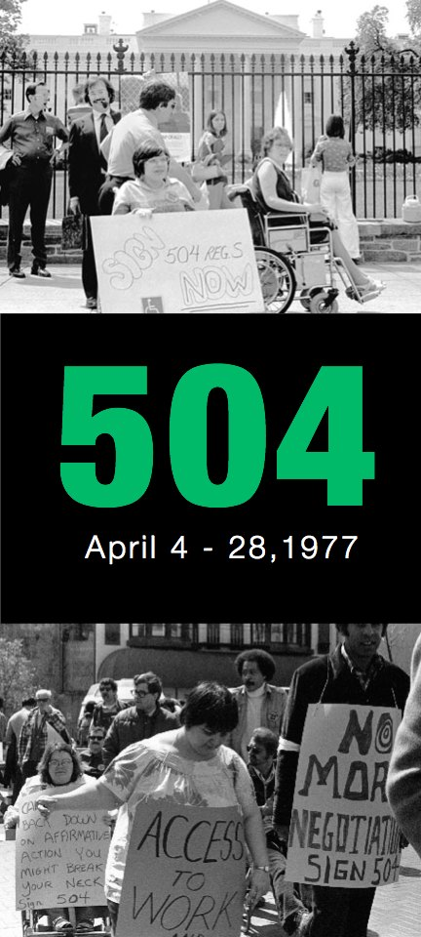

DISABILITY RIGHTS LAWS IN HIGHER ED
Passed as a result of civil unrest and protest
Protect students with disabilities from discrimination, exclusion, denial of educational benefits; support “reasonable accommodations”
About removing barriers to ACCESS

Slide 7
REASONABLE ACCOMMODATION (IN BRIEF)
Not an advantage; about removing the barrier to equal access:
Testing accommodations
Sighted lab assistance, interpreting, CART, captioning
Classroom relocation, accessible furniture
Alternate text formats
Peer note taking
Assistive technology and software
Accessible transportation and housing
Attendance and deadline flexibility

Slide 8
Accommodation Process Overview
Disclosure + Request
Interactive Process
Letter of Accommodation
Implementation
Must begin with disclosure of disability and request for accommodations
Interactive Process
Letter of Accommodation
Implementation
If there are issues or concerns with implementation, we may have to re-enter the interactive process
  If it is determined that accommodations must be amended or changed, a new letter of accommodation is created and new accommodations are implemented

Slide 9

WHEN YOU RECEIVE AN LOA
  Don’t feel pressure to respond immediately
  Do not deny accommodations without contacting DRC.
  Consider what you say: this conversation is sensitive, and jokes or off-hand remarks can be very impactful in this moment
  Schedule a time to meet; concentrate on accommodations (not diagnosis); put implementation plan in writing

Slide 10
Online Accessibility: Keep in mind students who...
Navigate computers and the web using only their keyboard (the mouse is a tool for sighted people who have full range of hand/arm motion)
Rely on assistive technology (screen readers, speech-driven navigation software, screen magnification, etc.) to access your course
Cannot see the beautiful graphics you put up, but still want/need the information that graphic content conveys
Cannot hear the audio/video content you put up but still want/need the information that A/V content conveys
Obviously these students deserve to learn just like their colleagues.

Slide 11
“Quick Guide” for Online Course Accessibility
Available at go.uic.edu/AccessibleDocs
On DRC website under “Faculty” menu

Slide 12
QUESTIONS?
(312) 413-2183 (Google Voice) DRC.UIC.EDU DRC@UIC.EDU
[Phone number] DCC.UIC.EDU DCC@UIC.EDU
Disability Resource Center | Disability Cultural Center

