Slide 1
Disability Resource Center: Supporting Future Doctors with Disabilities
Disability Resource Center (DRC)
Supporting Future Doctors with Disabilities
Access copy of this presentation available for download at drc.uic.edu/presentations

Slide 2
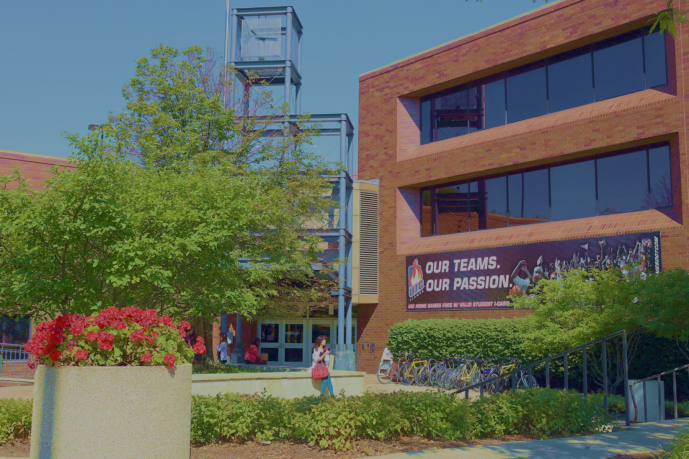
UIC Disability Resource Center Contact Info
Located in Suite 1070 of SSB 1200 W Harrison Street
drc.uic.edu
drc@uic.edu
312-413-2183

Slide 3
DRC BASICS
THE DISABILITY RESOURCE CENTER REPORTS TO THE OFFICE FOR ACCESS AND EQUITY
Disability Resource Center – provides student accommodation for the entire University system.
Office of Access and Equity – provides employee accommodation for faculty, staff and students; provides Title IX compliance and training and handles discrimination complaints.
Disability Cultural Center – Is one of the seven Centers for Cultural Understanding and Social Change on campus and a source of pride for students.

Slide 4
SAMPLE OF REASONABLE ACCOMMODATION (IN BRIEF)
Students who receive reasonable accommodation are not receiving an advantage.
A barrier is being removed and equal access is granted.
Testing accommodations
Sign language interpreting, CART (real time captioning)
Classroom relocation, accessible furniture
Alternate text formats
Peer note taking
Assistive technology and software
Accessible transportation and housing
Attendance and deadline flexibility
Notes:
Here is a list of reasonable accommodation that our office may provide to students who engage in the process.

Slide 5
Accommodation Process Overview
Student must self-identity and provide documentation.
Student will engage in an interactive process including an intake appointment and medical history discussion.
Once the process is completed, the student will receive their Letter of Accommodation (LOA) and the COM administrators.
COM will implement services.
If there are issues or concerns with implementation, we may have to re-enter the interactive process.
Notes:
The accommodation process is a fluid cycle: 1. the student will self identity (provide documentation); 2. engage in the process; 3. it is determined by the disability specialist reasonable accommodations and a letter of accommodation (LOA) is given to the student; 4. the student shares the letter of accommodation with faculty or program for implementation.

Slide 6
REASONABLE ACCOMMODATIONS
NOT of a personal nature (personal care attendant, mobility equipment, etc.)
CANNOT pose a direct threat to student or others
CANNOT significantly alter curriculum (essential elements of course)
Based on curriculum, not speculation or generalizations about the field, workforce, “real world,” etc.
Notes:
What types of accommodations will not be provided?
Personal devices such as wheelchairs, hearing aids or glasses.
Accommodations that would fundamentally alter the nature of a program will not be provided.
Accommodations that are unduly burdensome, administratively or financially.

Slide 7
SPECIAL CONSIDERATIONS FOR MEDICAL STUDENTS
Physicians with disabilities contribute to the diversity of the profession and bring unique insights to the practice of medicine.
We can provide accommodation for chronic health and mental health conditions.
We are working remotely and performing intakes over the phone.
DRC can approve accommodations for all tests except Step 1 and 2 exams.
DRC can help you package your application
Start on this right after M1

Slide 8
QUESTIONS?
Visit us at drc.uic.edu!
Disability Resource Center | Office of Access and Equity

