Slide 1
Supporting Neurodivergent Students
Helen Rottier + Sophia Hamilton
French Department
October 7, 2020
Presentation available for download at drc.uic.edu/presentations

Slide 2
Agenda
What is (academic) ableism?
Introduction to Neurodiversity
How can faculty/staff support students?
DRC
CANS
Questions

Slide 3
What is ableism?
Notes:
Ask for 2-3 responses.

Slide 4
What is ableism?
the systemic oppression of people with disabilities; akin to racism, sexism, other oppression of people based on identities
occurs individually, in/against groups and communities, and in structures, systems, and institutions
includes microaggressions, attitudes and biases, access barriers, inequity

Slide 5
What is academic ableism?
systemic oppression and exclusion of disabled students, faculty, scholars from academic spaces

Slide 6
What is academic ableism?
“steep steps”- academia is inherently and iconically ableist/exclusionary
Notes:
Give examples of Attitudinal, Physical, Documentation/Disclosure, Sensory, Accommodations, and/or Flexibility Barriers.

Slide 7
So what do we (as students/faculty/ administrators) do?
Reimagine sites of knowing, thinking, and being (and valuing knowing, thinking and being) that allow for disabled scholarship.
This is the long-term, eventual goal!
Use accommodations, disability services, and supports to open windows/doors into academia.
This is what we are focusing on.

Slide 8
Introduction to Neurodiversity
Neurodiversity is the understanding that different ways of thinking are expected in a diverse human population.
Neurodiversity is built upon the social model of disability and the disability rights movement.
Neurodiversity is for everyone!
Notes:
Raise your hand if you have ever heard of neurodiversity.
-not inherently bad or good, it just is
-destigmatizing and depathologizing neurodivergence
-still recognizes disabilities
-for EVERYONE (intersectionality, other kinds of disabilities, including intellectual disability and people with higher support needs)

Slide 9
Supporting ND Students
Recognize that every ND student is a whole student with strengths, challenges, interests, and needs.
Connect ND students with one another and with other disabled students and faculty.
Default to high expectations, high support (and adjust with individual students).
Listen to ND students, listen to ND professionals, listen to ND people overall.
Notes:
Emphasize self-advocacy skills and mental health as priorities.

Slide 10
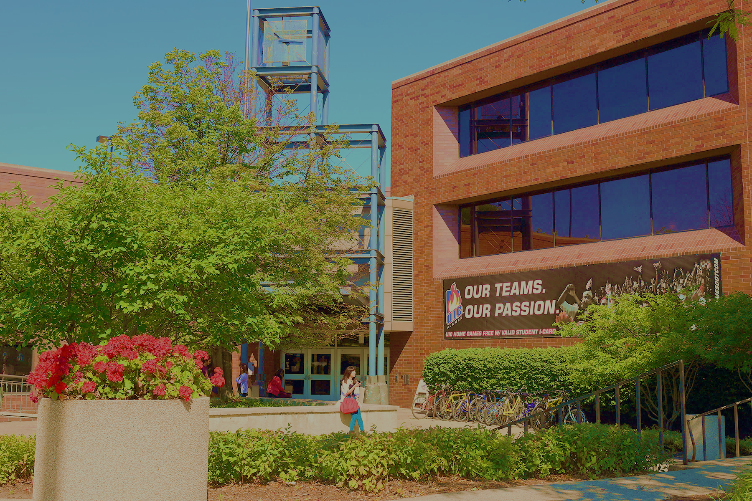
Located in Suite 1070 of SSB 1200 W Harrison Street
http://drc.uic.edu // drc@uic.edu
312-413-2183

Slide 11
REASONABLE ACCOMMODATION (IN BRIEF)
Not an advantage; about removing the barrier to equal access:
Testing accommodations
Sighted lab assistance, interpreting, CART, captioning
Classroom relocation, accessible furniture
Alternate text formats like audio, Braille
Peer note taking
Assistive technology and software
Accessible transportation and housing
Attendance and deadline flexibility

Slide 12
Accommodation Process Overview
Disclosure + Request
Interactive Process
Letter of Accommodation
Implementation
Must begin with disclosure of disability and request for accommodations
Interactive Process
Letter of Accommodation
Implementation
If there are issues or concerns with implementation, we may have to re-enter the interactive process
If it is determined that accommodations must be amended or changed, a new letter of accommodation is created and new accommodations are implemented
Ex) If student or instructor finds that accommodation is unreasonable or impossible to implement, DRC will work collaboratively to find alternative and/or revamp letter

Slide 13
FIVE QUICK UD/UDL TIPS FOR STUDENT AFFAIRS
Space:
Representation:
Class Scheduling:
- Sleep hygiene: can a student be up early in the morning or late at night?
- Time between classes: is there adequate time to get from place to place and/or to decompress and study?
- Part Time vs. Full Time
Ensure that there is a wide and clear path through your space and that furniture accounts for a variety of body shapes and needs
For virtual “spaces”: go.uic.edu/AccessibleDocs provides tips for universally accessible online classes
Communication:
- Use “multi-modal” strategies - visual as well as verbal cues while working with students
- Highlight important information; group and color code information
- Use examples that are relevant and engaging to students
provide structured and clear roadmap for conversations and socially constructed assignments; set social expectations; avoid jargon; clarify new terms; listen + repeat + clarify
Materials:
- Caption all video materials
- Ensure that materials are available in digital format and that formats are accessible

Slide 14
Coalition for Autistic and ND Students (CANS)
By and for autistic and ND students in the Chicago area.
community college, undergraduate, and graduate students
Columbia College, DePaul University, Roosevelt University, UIC, and others!
Group co-mentoring/peer network framework
Monthly meetings with discussion and activities, special events each semester!

Slide 15
Key Points
All disabled students/staff/faculty deal with academic ableism. It is built into higher education.
As we reimagine more inclusive education/knowledge production, we must also support the students/staff/faculty who are already here.
Supporting ND students begins and ends with listening to that student and to ND communities.

Slide 16
Questions?

Slide 17
Questions?
Feel free to contact us with additional questions and/or request more information/conversation/resources.
Email: hrotti2@uic.edu Email: shami3@uic.edu
Twitter: @helenrottier

