Slide 1
UIC College Spotlight for CPS
UIC College Spotlight for CPS
Diverse Learners
Available for download at drc.uic.edu/presentations

Slide 2
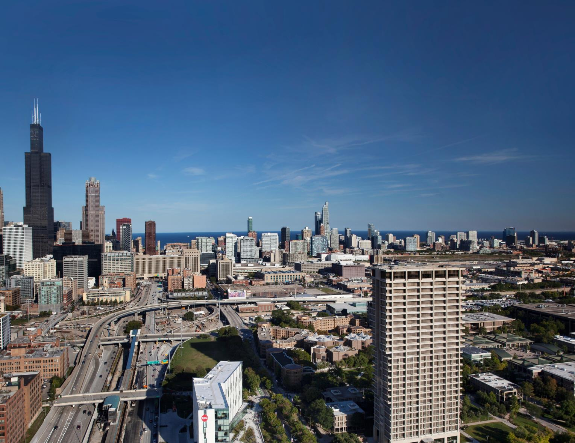

Welcome to UIC
WELCOME
TO UIC

Slide 3
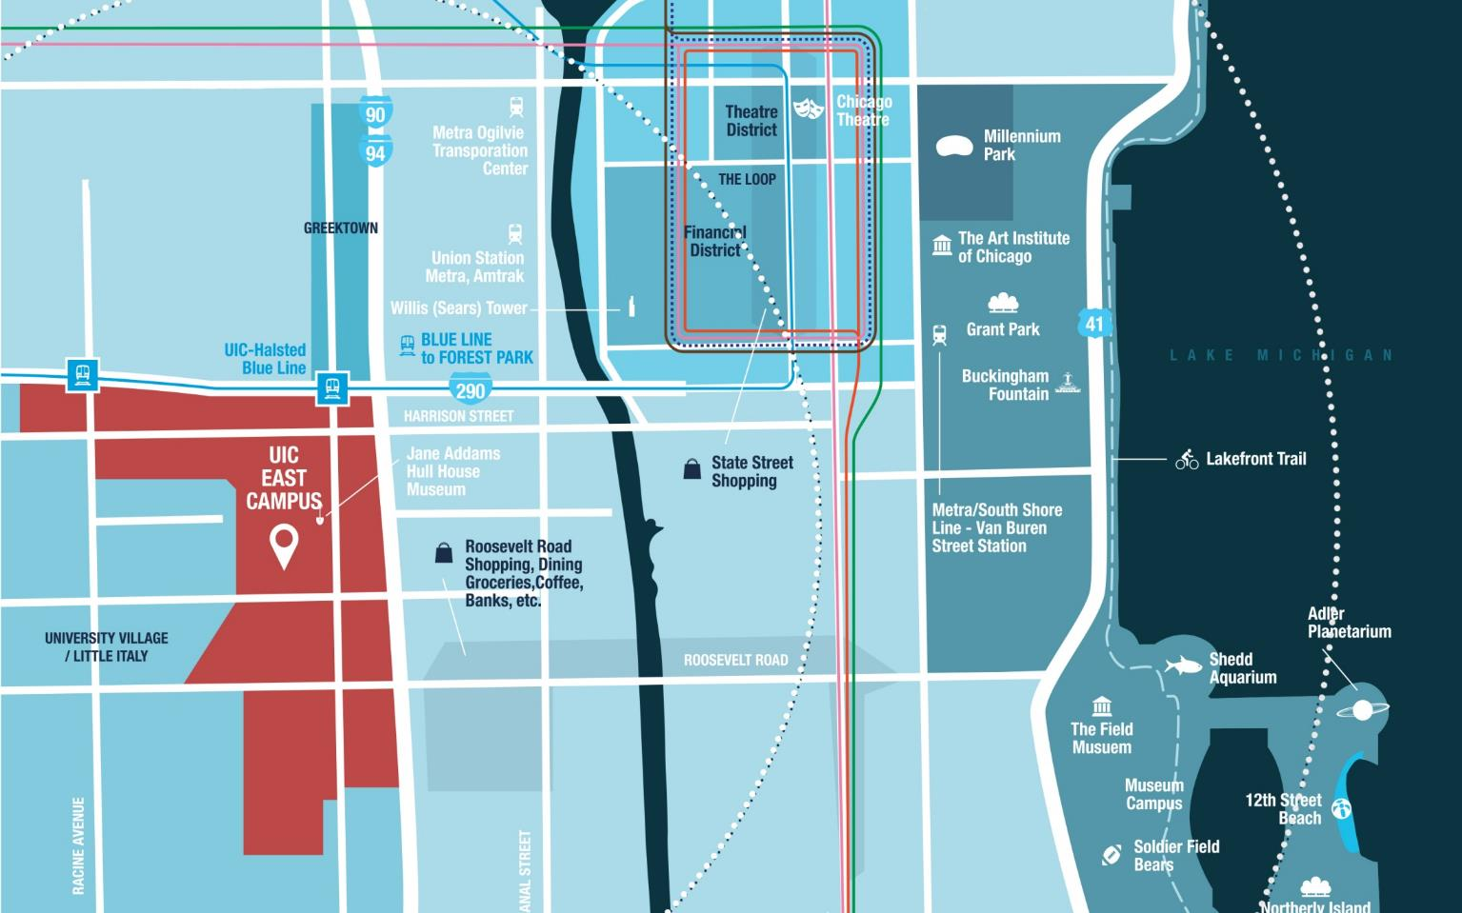



Chicago’s Public Research University
N
YOU
ARE
HERE
CHICAGO’S PUBLIC RESEARCH UNIVERSITY

Slide 4

UIC Undergraduate Classroom Numbers
35%
OF CLASSES UNDER 20 STUDENTS
21,641
80%
UNDERGRADUATES
OF CLASSES UNDER 50 STUDENTS
ACCESS EXCELLENCE
19:1
STUDENT:FACULTY
RATIO

Slide 5

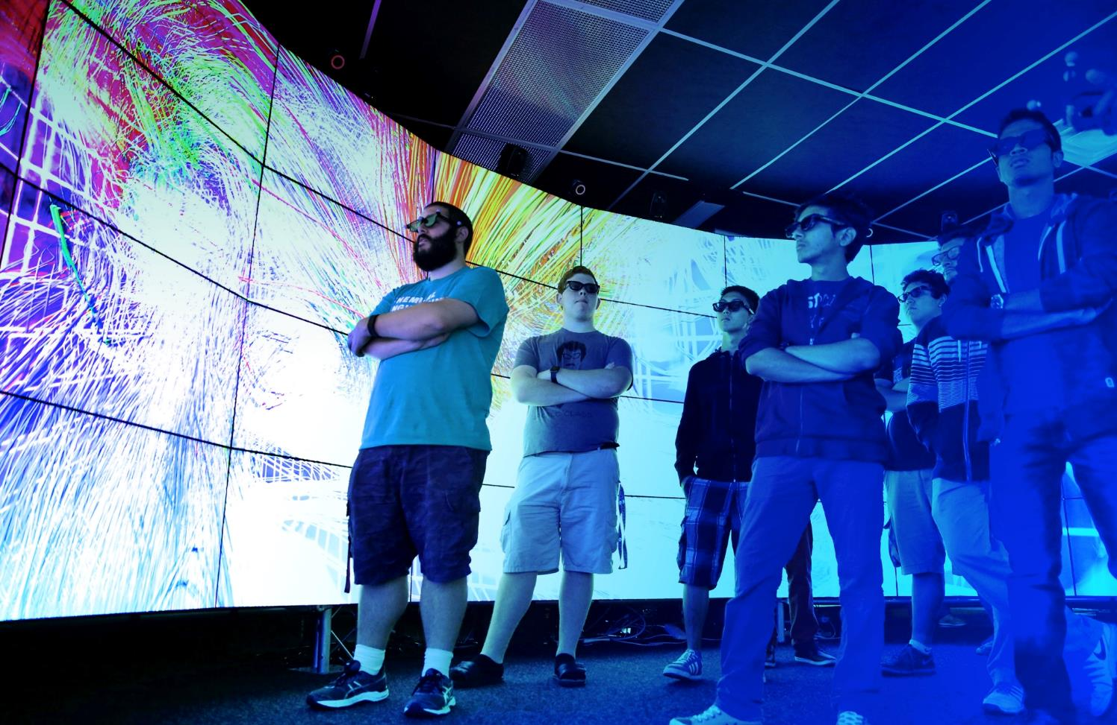

A World Class Research Institution
RESEARCH
UNIVERSITY
$412
MILLION
IN SPONSORED RESEARCH
INSPIRE DISCOVERY
WORLD-CLASS
TOP 200
RESEARCH INSTITUITIONS
IN THE WORLD

Slide 6

Experience Diversity
40%
FIRST GENERATION STUDENTS
33%
MULTI-LINGUAL
& 57 DIFFERENT
LANGUAGES
EXPERIENCE DIVERSITY
NO
ETHNIC OR CULTURAL
MAJORITY
AMONG THE
STUDENT BODY

Slide 7
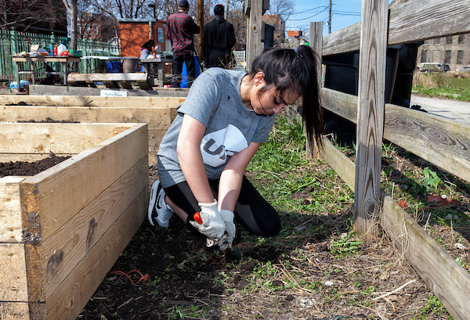
Leadership and Civic Engagement
A CAMPUS COMMITTED TO
SOCIAL
GOOD
GREAT
CITIES
WASHINGTON MONTHLY
COMMITMENT
STUDENT
LEADERSHIP &
CIVIC
ENGAGEMENT

Slide 8

How to Apply
HOW TO APPLY

Slide 9

First Year Application
APPLY
Common
Application
Official
Transcripts
HOW TO APPLY (FIRST-YEAR)
Standardized
Test Scores
*OPTIONAL*
Personal Statement
Letters of Recommendation *OPTIONAL*
Grade Trends / GPA
Strength of Schedule
Test Scores *OPTIONAL*
Application
Fee OR
Fee Waiver

Slide 10
Application and Decision Dates
Application
Fee
EARLY
ACTION
Deadline: Nov. 1
Decision by Dec. 1
REGULAR
DECISION
Deadline: Feb. 1
Decision:
Dec. — Apr.
HOW TO APPLY (FIRST-YEAR)
*DEC. 1
Honors College
GPPA
Priority Scholarship

Slide 11

Paying for College
PAYING FOR
COLLEGE

Slide 12


Tuition and Fees
PLUS OPTIONAL
TUITION & FEES
(2020-2021 Rates)
PLAN FOR ESTIMATED
$1,346
Health
Insurance
$7,982
Campus
Housing
$3,088
Meal
Plan
$13,892
IN-STATE
+
PAYING FOR COLLEGE
$1,400
Books &
Supplies
$1,452
Transport-
ation
$3,767
Personal
Expenses
$27,584
NON-RESIDENT

Slide 13

Financial Aid and Scholarships
NEED-
BASED
Financial Aid
MERIT-
BASED
Scholarships
HOW TO QUALIFY
FAFSA (fafsa.ed.gov)
Illinois Rise Act Application (isac.org)
HOW TO QUALIFY
UIC Application
Priority Scholarship Date
PAYING FOR COLLEGE
LOANS
GRANTS
STUDENT
EMPLOYMENT

Slide 14


UIC Mission
“To create knowledge that transforms our views of the world and, through sharing and application, transforms the world.”
-UIC mission

Slide 15



Where to Find More UIC Information
ASK QUESTIONS. QUESTION
ANSWERS.
admissions.uic.edu
discover.uic.edu
admissions@uic.edu

Slide 16
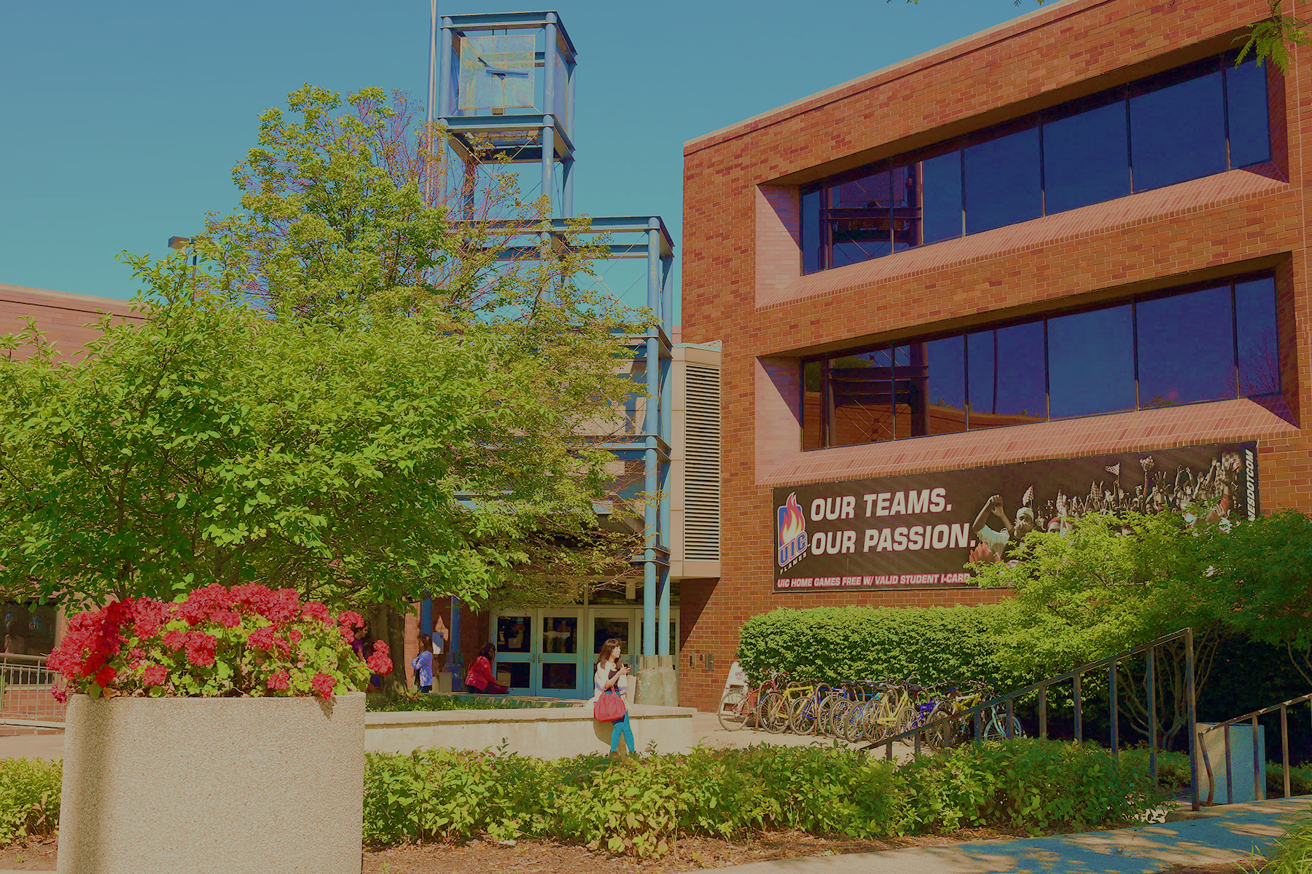

UIC Disability Resource Center
Located in Suite 1070 of SSB
1200 W Harrison Street
http://drc.uic.edu
drc@uic.edu
312-413-2183

Slide 17
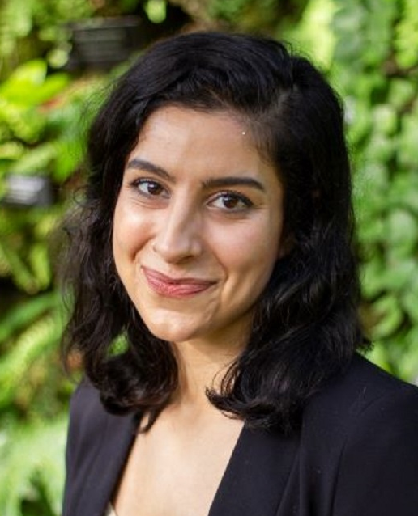
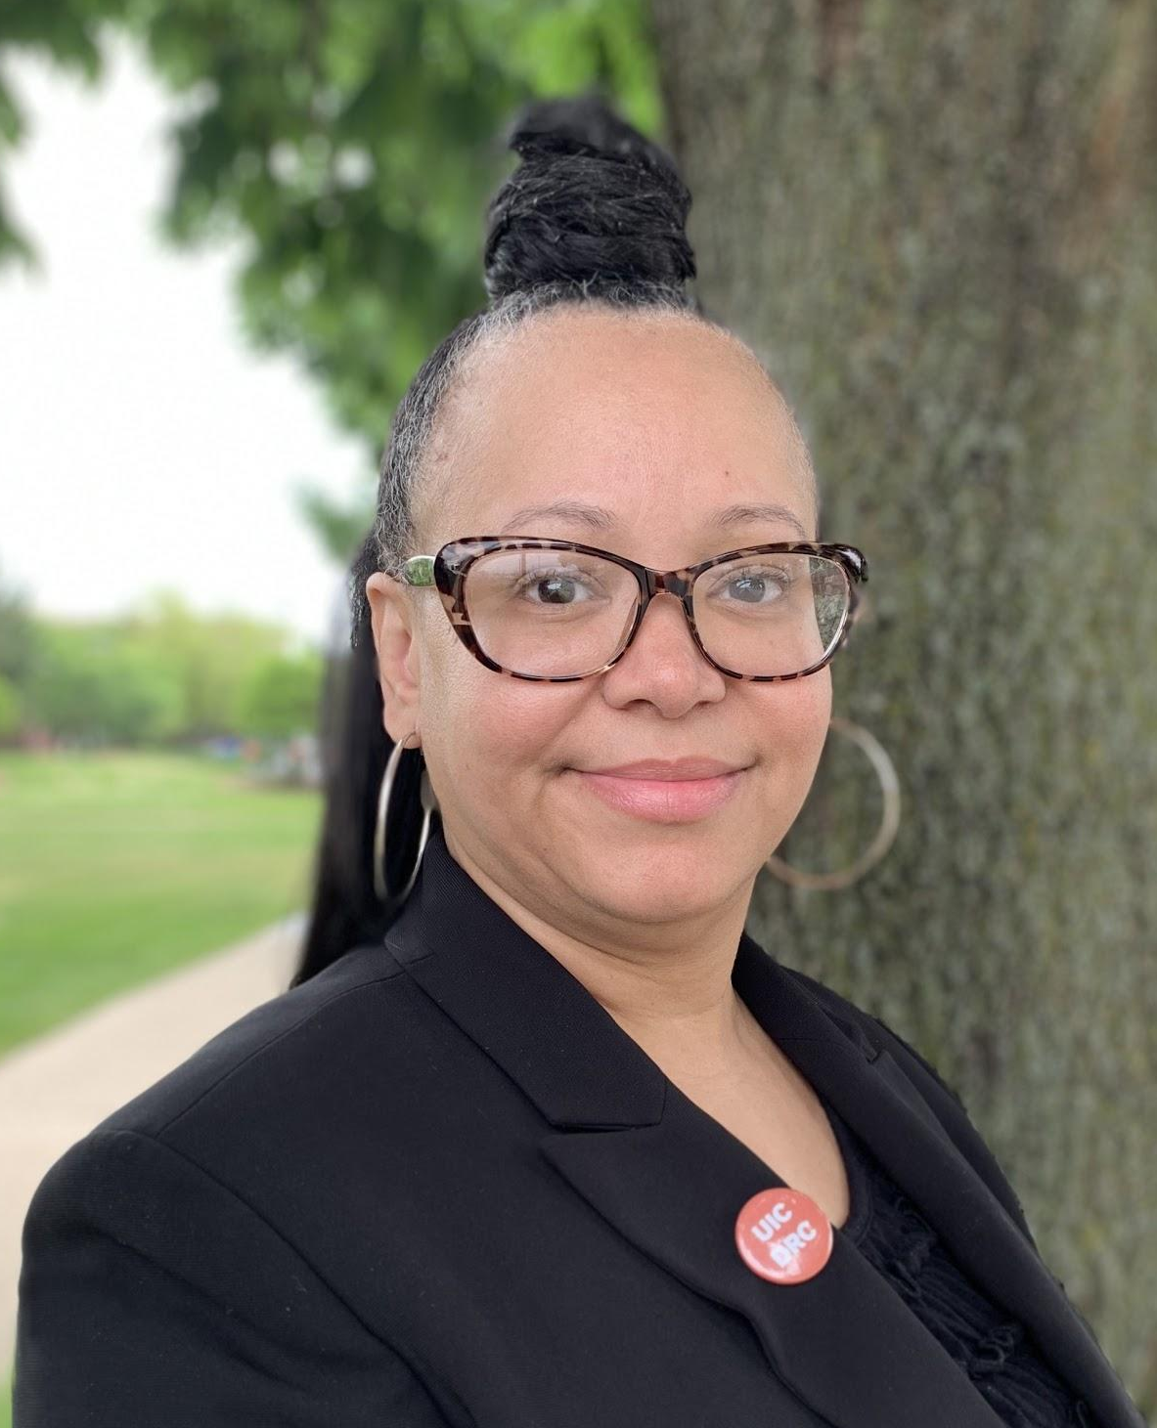
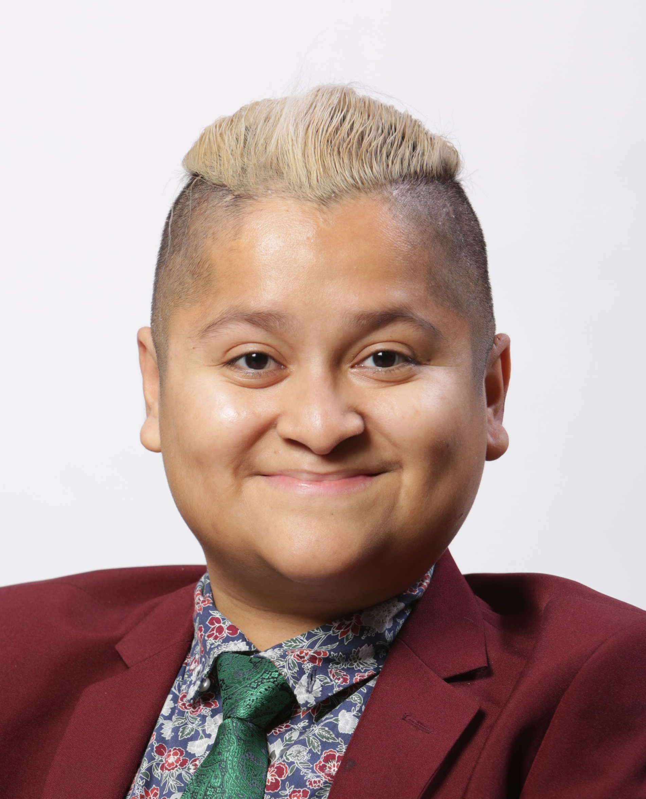
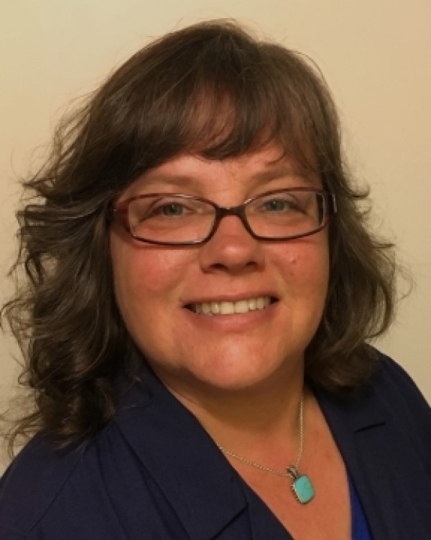
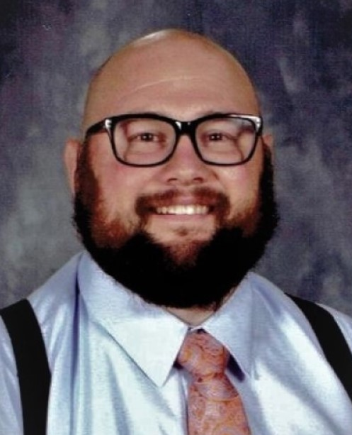
Meet the DRC Team
Director of DRC
Sophia Hamilton
Assistant Director of Health Science Disability Resource
Kimberly Gardiner
Disability Services Specialist
Hugo Trevino
Disability Services Specialist
Gail Makuch
Accessible Document & Technology Specialist
Nick Esposito

Slide 18
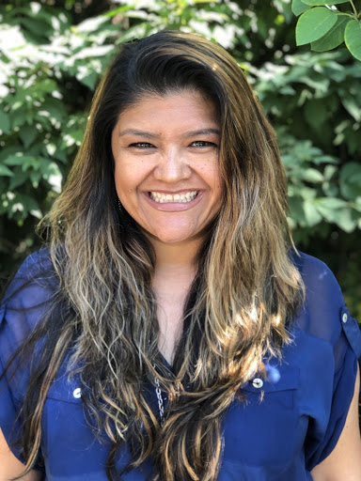
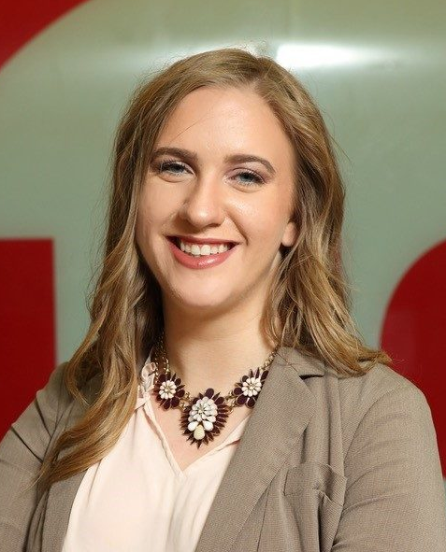
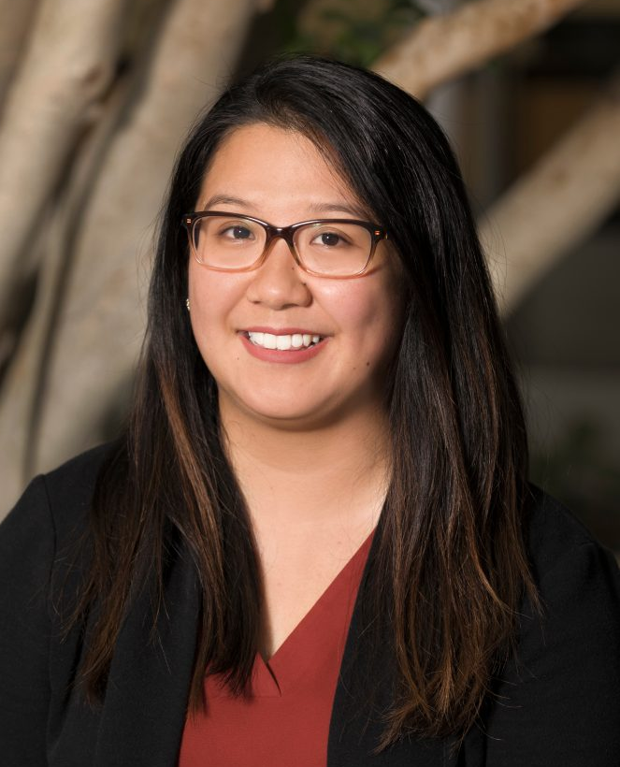
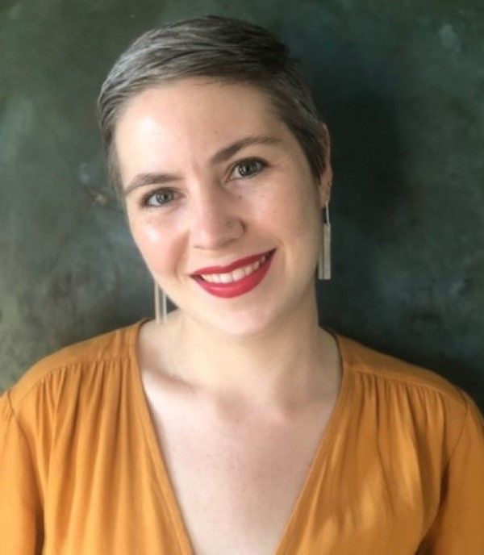
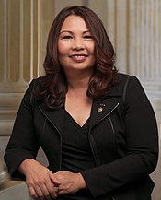
Meet the DRC Team Pt. 2
Office Administrator
Jesse Gutierrez
Testing Coordinator
Kelly Gerhardt
Testing Coordinator
Christine Guzman
Graduate Assistant - Testing Coordinator & Document Converter
Nicole Sims
Undergrad & Grad
Lab Aides and Office Helpers

Slide 19
Programs/Services Offered by DRC
Services:
Academic Accommodations to ensure equal access to the college experience for students with disabilities (learn more on our Accommodations Guide)
Referrals to on and off campus resources, such as tutoring, advising, counseling, housing and employment resources.

Slide 20
Application Process
Complete Student Registration Form -- you can upload your IEP/504 and relevant supporting documentation from High School as documentation on the bottom of the form.
Schedule an intake appointment with a Disability Services Specialist by calling (312) 413-2183
Review our documentation guidelines and upload if you didn’t on your form (check out our Registration Page for more info)
When to apply: End of May/Beginning of June

Slide 21
Mental Health Resources
Counseling Center: provides free short term counseling (12 meetings), crisis management, group therapy, and assistance locating long term care
Appointments available by calling (312) 996-3490 // Counseling Center website
Office of Applied Psychological Services (OAPS): provides unlimited therapy sessions and assessment/diagnosis services at sliding scale rates
Appointments available by calling (312) 996-2540 // OAPS Brochure
Neuropsychiatric Institute (NPI): provides full pscyhoeducational assessment for students on Campus Care insurance with referral from Primary Care Physician
Referral through Primary Care Physician // NPI Website

Slide 22




Disability Specific Resources
Disability Cultural Center: affirms and celebrates disability communities by exploring intersectional identities, developing disability culture, fostering a sense of belonging, and fighting for social justice.
SUCCEEDS Clinic: a resource dedicated to providing services to UIC students with ADHD who are struggling with academic or mental health difficulties
Coalition of Autism and Neurodivergent Students (CANS): a student-led community for autistic and neurodivergent college students to meet friends, share resources, and participate in workshops, activities, and advocacy.
Chicagoland Disabled People of Color Coalition (DPOCC): a group founded by, centered around, and run by disabled, Deaf, autistic, and neurodivergent people of color

Slide 23
Supplemental Materials
DRC 101 Workshops:
Do you know your rights as a college student with a disability? Do you feel comfortable explaining your needs and being a self-advocate? Join us for an info session where you will learn about all the Disability Resource Center and Disability Cultural Center, and how you can hit the ground running with your accommodations in the Fall semester. Family and friends are welcome!
DRC 101 workshops are available throughout the summer (check website for dates) and by request for High Schools; DRC 101 Powerpoint is available for download at any time.
DRC Flier for Download
DRC Folleto en Español

Slide 24

UIC Disability Cultural Center
UIC Disability Cultural Center
bit.ly/accessUICDCC

Slide 25
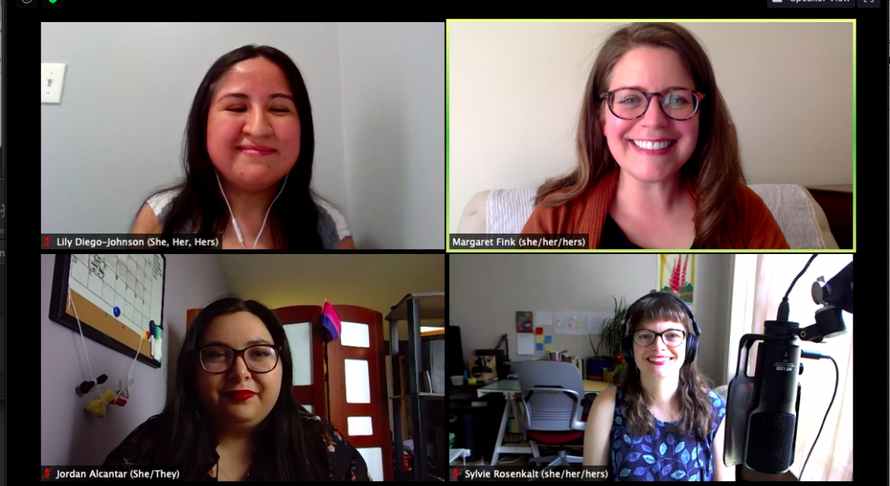
A national leader
A national leader
One of five staffed, stand-alone disability cultural centers in the United States

Slide 26
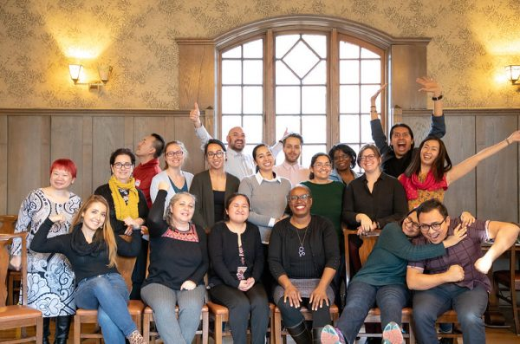
Dedication to Diversity
Part of a campus collective dedicated to diversity
One of seven Centers for Cultural Understanding and Social Change at UIC

Slide 27

DCC Mission
The UIC DCC affirms and celebrates disability communities by exploring intersectional identities, developing disability culture, fostering a sense of belonging and fighting for social justice.

Slide 28

Lectures / Public Events

Slide 29



Building community

Slide 30
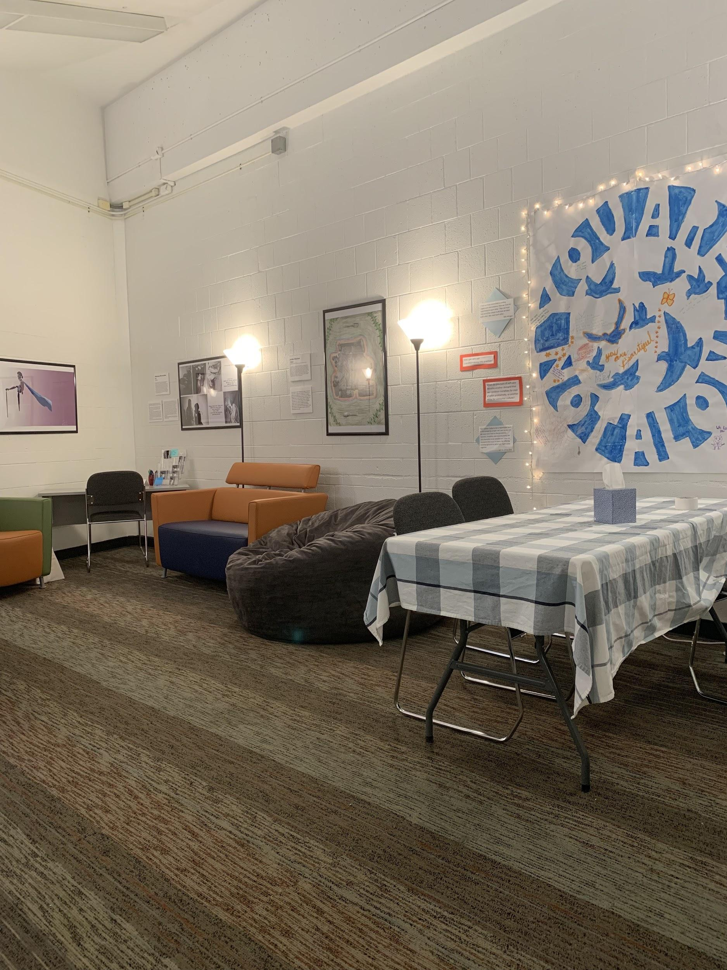
Our space
Behavioral Sciences Building, Room 235
(Corner of Harrison and Morgan)
Notes:
ID: An open room with white cinderblock walls and framed artwork. There are lamps, couches, a beanbag chair, and a long table covered with a checked tablecloth. On the wall is a painted mural that says "you are not alone" and is covered with fairy lights.

Slide 31





Find us on social media
Check in with us!
dcc@uic.edu
312-355-7050
Facebook: @Uic.DisabilityCulturalCenter
Instagram: @uic.dcc

