Slide 1
DRC 101
DRC Basics for First Year Seminar
Students
Presentation available for download at:
drc.uic.edu/presentations

Slide 2
AGENDA
DRC Basics
Civil Rights for Individuals with Disabilities
Defining Disability
Disability Resource Center Process
Resources

Slide 3
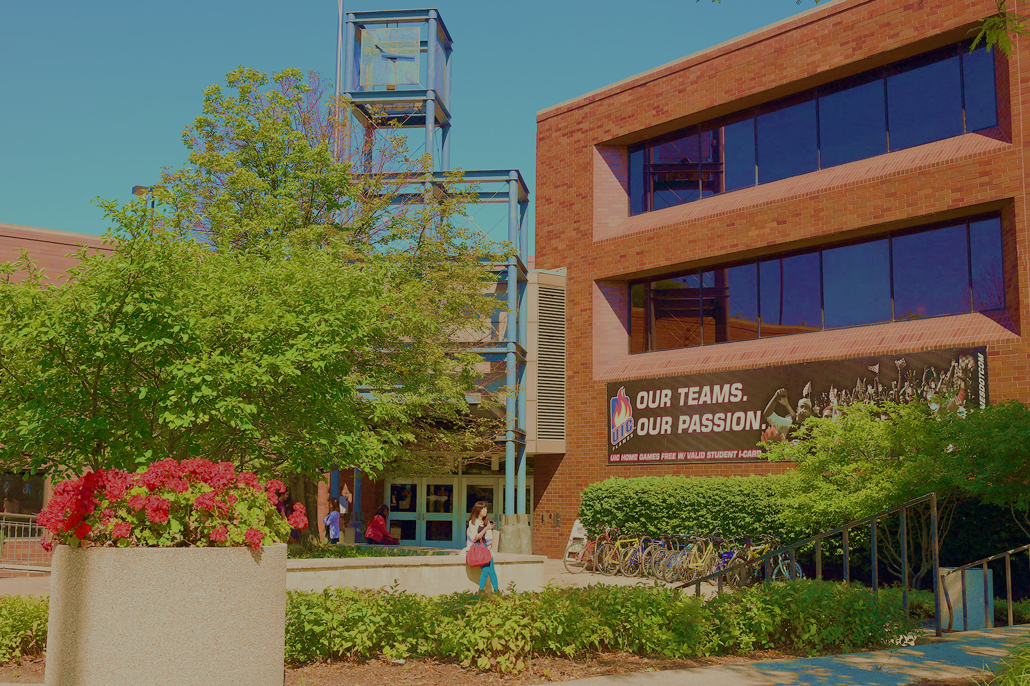
Located in Suite 1070 of SSB
1200 W Harrison Street
http://drc.uic.edu // drc@uic.edu
312-413-2183

Slide 4
The Americans with Disabilities Act (ADA) had an important birthday last year? How old is the ADA?
A) 30 years old
B) 50 years old
C) 100 years old

Slide 5


DISABILITY RIGHTS LAWS IN HIGHER ED
Passed as a result of civil unrest and protest
Different legal protections than for K-12 students: guarantee equal ACCESS
At the college level:
Students with disabilities meet the same standards
You must ask for help if you need it (self-advocate)

Slide 6
DEFINING DISABILITY

Slide 7
ASK YOURSELF:
What is disability? What does disability mean to you, and where did you get that information?

Slide 8

HOW DO WE DEFINE DISABILITY?
Legally: a physical or mental impairment that substantially limits a major life function
Medical Model: a diagnosis; a problem within a person that needs to be “fixed”
Social model: environmental, attitudinal, and societal barriers cause disability

Slide 9
DISABILITY RESOURCE CENTER PROCESS

Slide 10

REASONABLE ACCOMMODATIONS
Not an advantage - about removing the barrier to equal access:
Testing accommodations
Sighted lab assistance, ASL interpreter, CART, captioning
Classroom relocation, accessible furniture
Alternate text formats like audio, Braille
Note taking - software or peer
Assistive technology and software
Accessible transportation and housing
Attendance and deadline flexibility

Slide 11

INTERACTIVE PROCESS
Determines reasonable accommodations that meet individual student’s needs
Made on a case-by-case basis
Based on disability documentation and student interview with Disability Specialist
Not prescriptive by disability – what works for one student may not be a good fit for another
What are the steps?
Registration Form
Intake appointment with your Disability Specialist
Letter of Accommodation - specifies your unique accommodation plan

Slide 12
QUESTIONS?
CALL US: (312) 413-2183
EMAIL US: DRC@UIC.EDU
WEBSITE: DRC.UIC.EDU
Disability Resource Center | Office of Access and Equity

